Slide 1
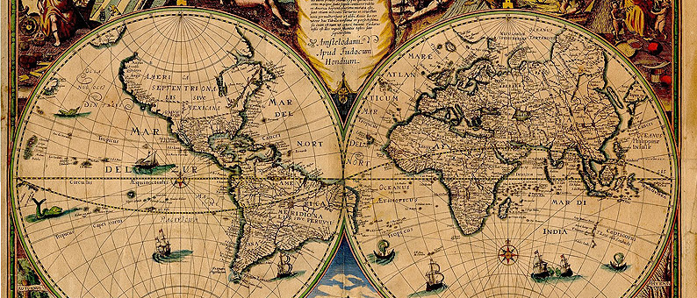

MOD004089 GIS Tools for Biodiversity Mapping and Conservation
Spatial Objects and Manipulation
Dr Hannah White

Slide 2
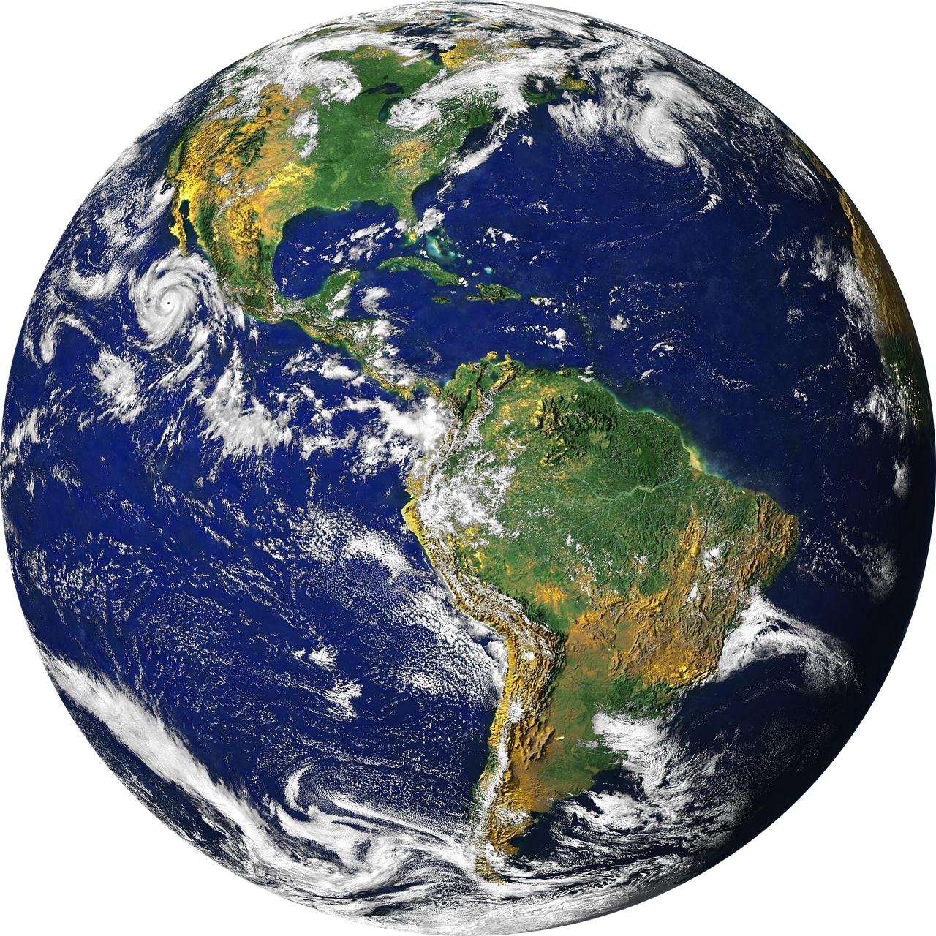
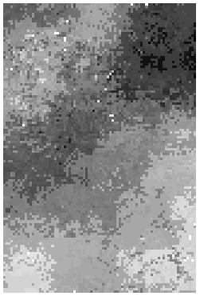
Modelling reality
Complex, 3D reality
Model to simplify reality
Raster
Vector

Slide 3
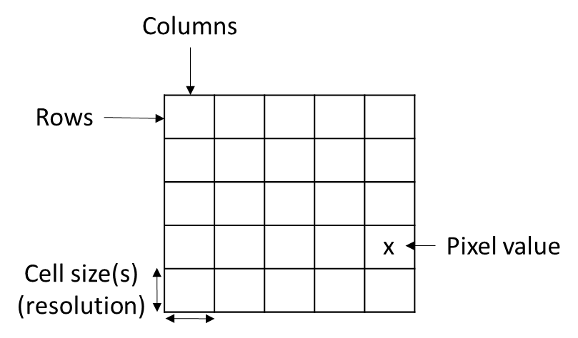
Rasters
Size/extent = cols x rows
Resolution affects accuracy of model and file size
Single value per cell
Exception: multiband images

Slide 4
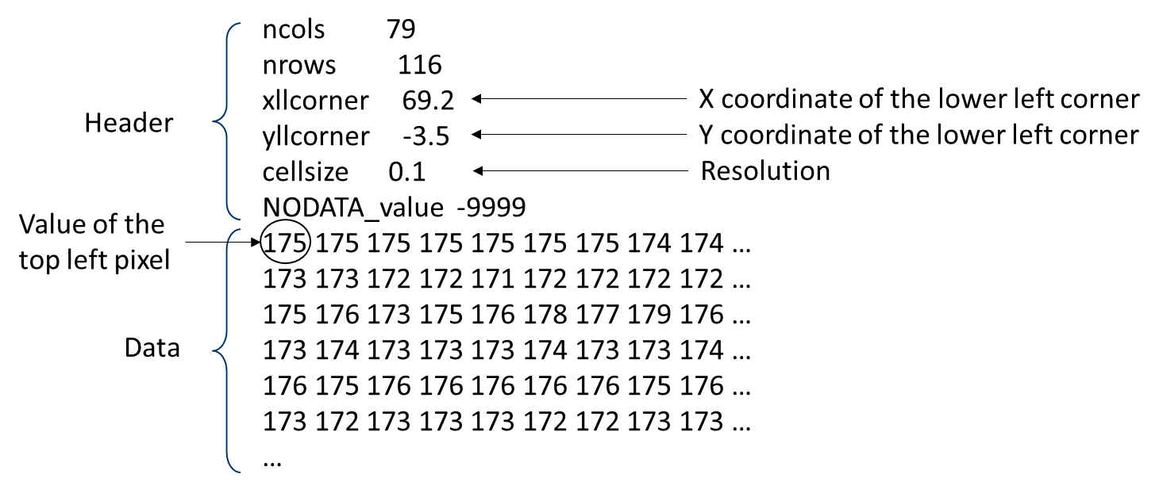
Raster file formats
JPEG (.jpg)
GeoTIFF (.tiff)
ERDAS Imagine (.img)
ESRI grid file (ArcGIS)
ASCII (.asc, .txt)

Slide 5
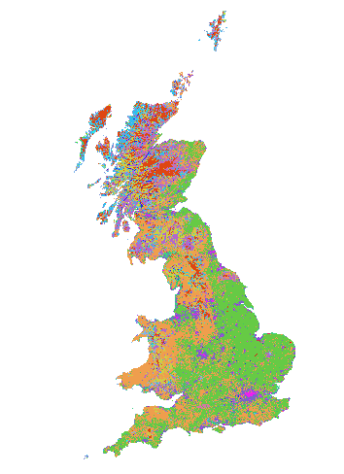
Commonly-Used Rasters
Digital Elevation Model
Bathymetry
Climate
Land Cover – discrete values
Binary
Continuous

Slide 6
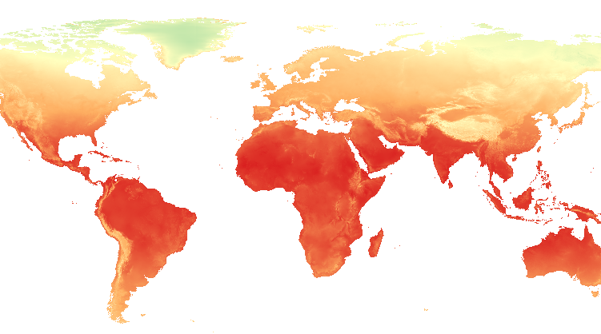
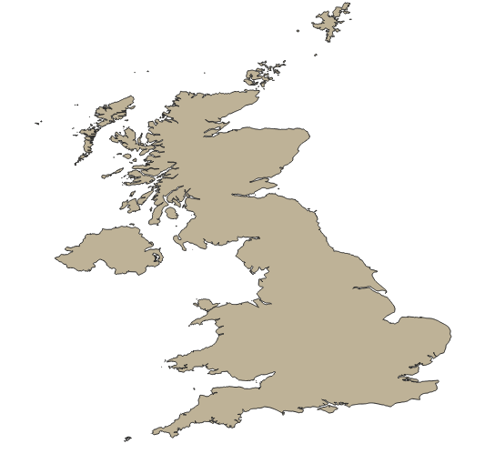
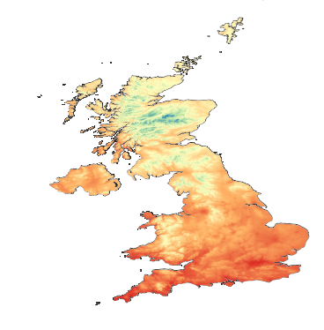
Raster Manipulation – Clip
Clips according to defined extent
Focus on area of interest
Reduces file size
Increase calculation speed

Slide 7
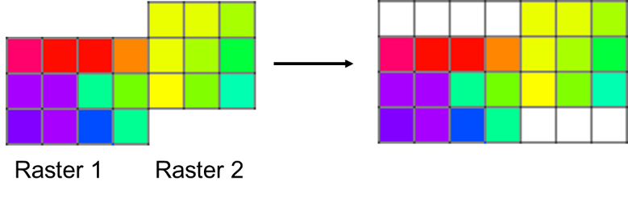
Raster Manipulation – Merge
Merge multiple rasters
Must have same resolution and projection
Must have no overlap

Slide 8
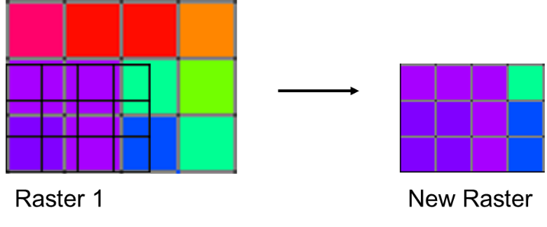
Raster Manipulation – Resample
Change resolution of raster
Define extent and cell size of output
Mathematical expression/algorithm to define new cell e.g. average
Changes values
Changes model of reality

Slide 9
Raster Manipulation – Raster Calculation
y₁ | y₂
y₃ | y₄
y = f(x)
x₁ | x₂
x₃ | x₄
1 | 1
0 | 1
>500m 1
<500m 0
Only changes information of cell
Applies function to raster
Can use conditional expressions
Can have multiple rasters as input

Slide 10
Vectors - Geography
What vector type you choose depends on aims of project
Points
(x, y)
(Poly)line
Polygon
Vertices have (x,y)

Slide 11
Vectors - Information
Each row of attribute table linked to single data point
Several variables per feature
One data row can be connected to several features
Can have several (connected) lines
Several variables per feature
One data row can be connected to several features
Severable variables per feature

Slide 12
Vectors Files
Shapefile (there are other less used file types)
Multiple files – keep together
.dbf contains information
Can edit but be careful

Slide 13
Vector Manipulations
Can affect geography, information or both
Select which objects to run processes on
Manually
By attribute
Based on spatial query

Slide 14

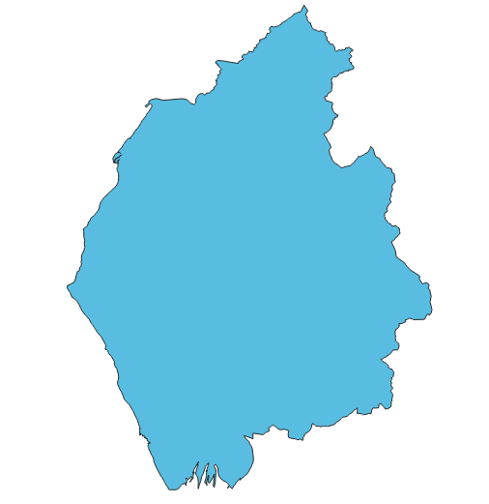
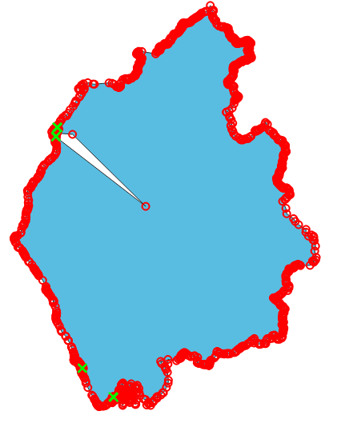
Vector Manipulations - Editing
Need to turn on editing
Edit geography
Move points
Edit vertices
Delete/add vertices

Slide 15
Vector Manipulations - Editing
Need to turn on editing
Edit geography
Move points
Edit vertices
Delete/add vertices
Edit information (attribute table)
Change value
Add new columns
Calculate new values e.g. Field Calculator

Slide 16
Vector Manipulations - Union
Layer 1
Layer 2
Union or Merge depending on software
Combines two vector layers into single layer
Must have same columns in attribute table
Can’t use on different vector types
Layer 3

Slide 17
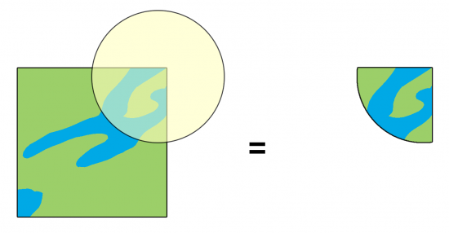
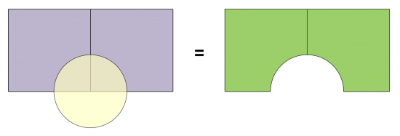
Vector Manipulations – Intersect and Difference
Ensure columns in attribute table match
Intersect
Works with points, polygons or lines
Difference
Layer 1 – Layer 2
Works with polygons

Slide 18
Vector Manipulations – Dissolve
Works on single layer
Use on polygons or lines
Creates new layer with changed information but same geography
 | A | 1
 | A | 3
 | A | 2
 | A | 4
 | A | 2

Slide 19
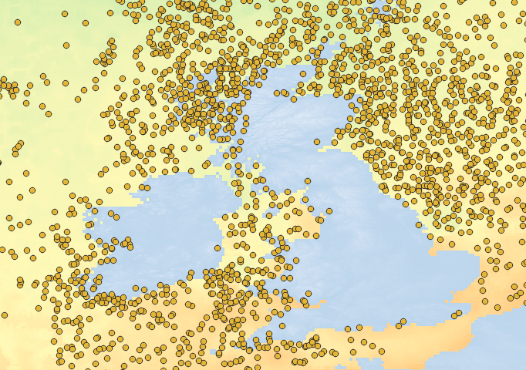
What have we talked about?
Manipulation of rasters and vectors can alter the geography, information or both
Always check – is the output what you expected?

